Slide 1
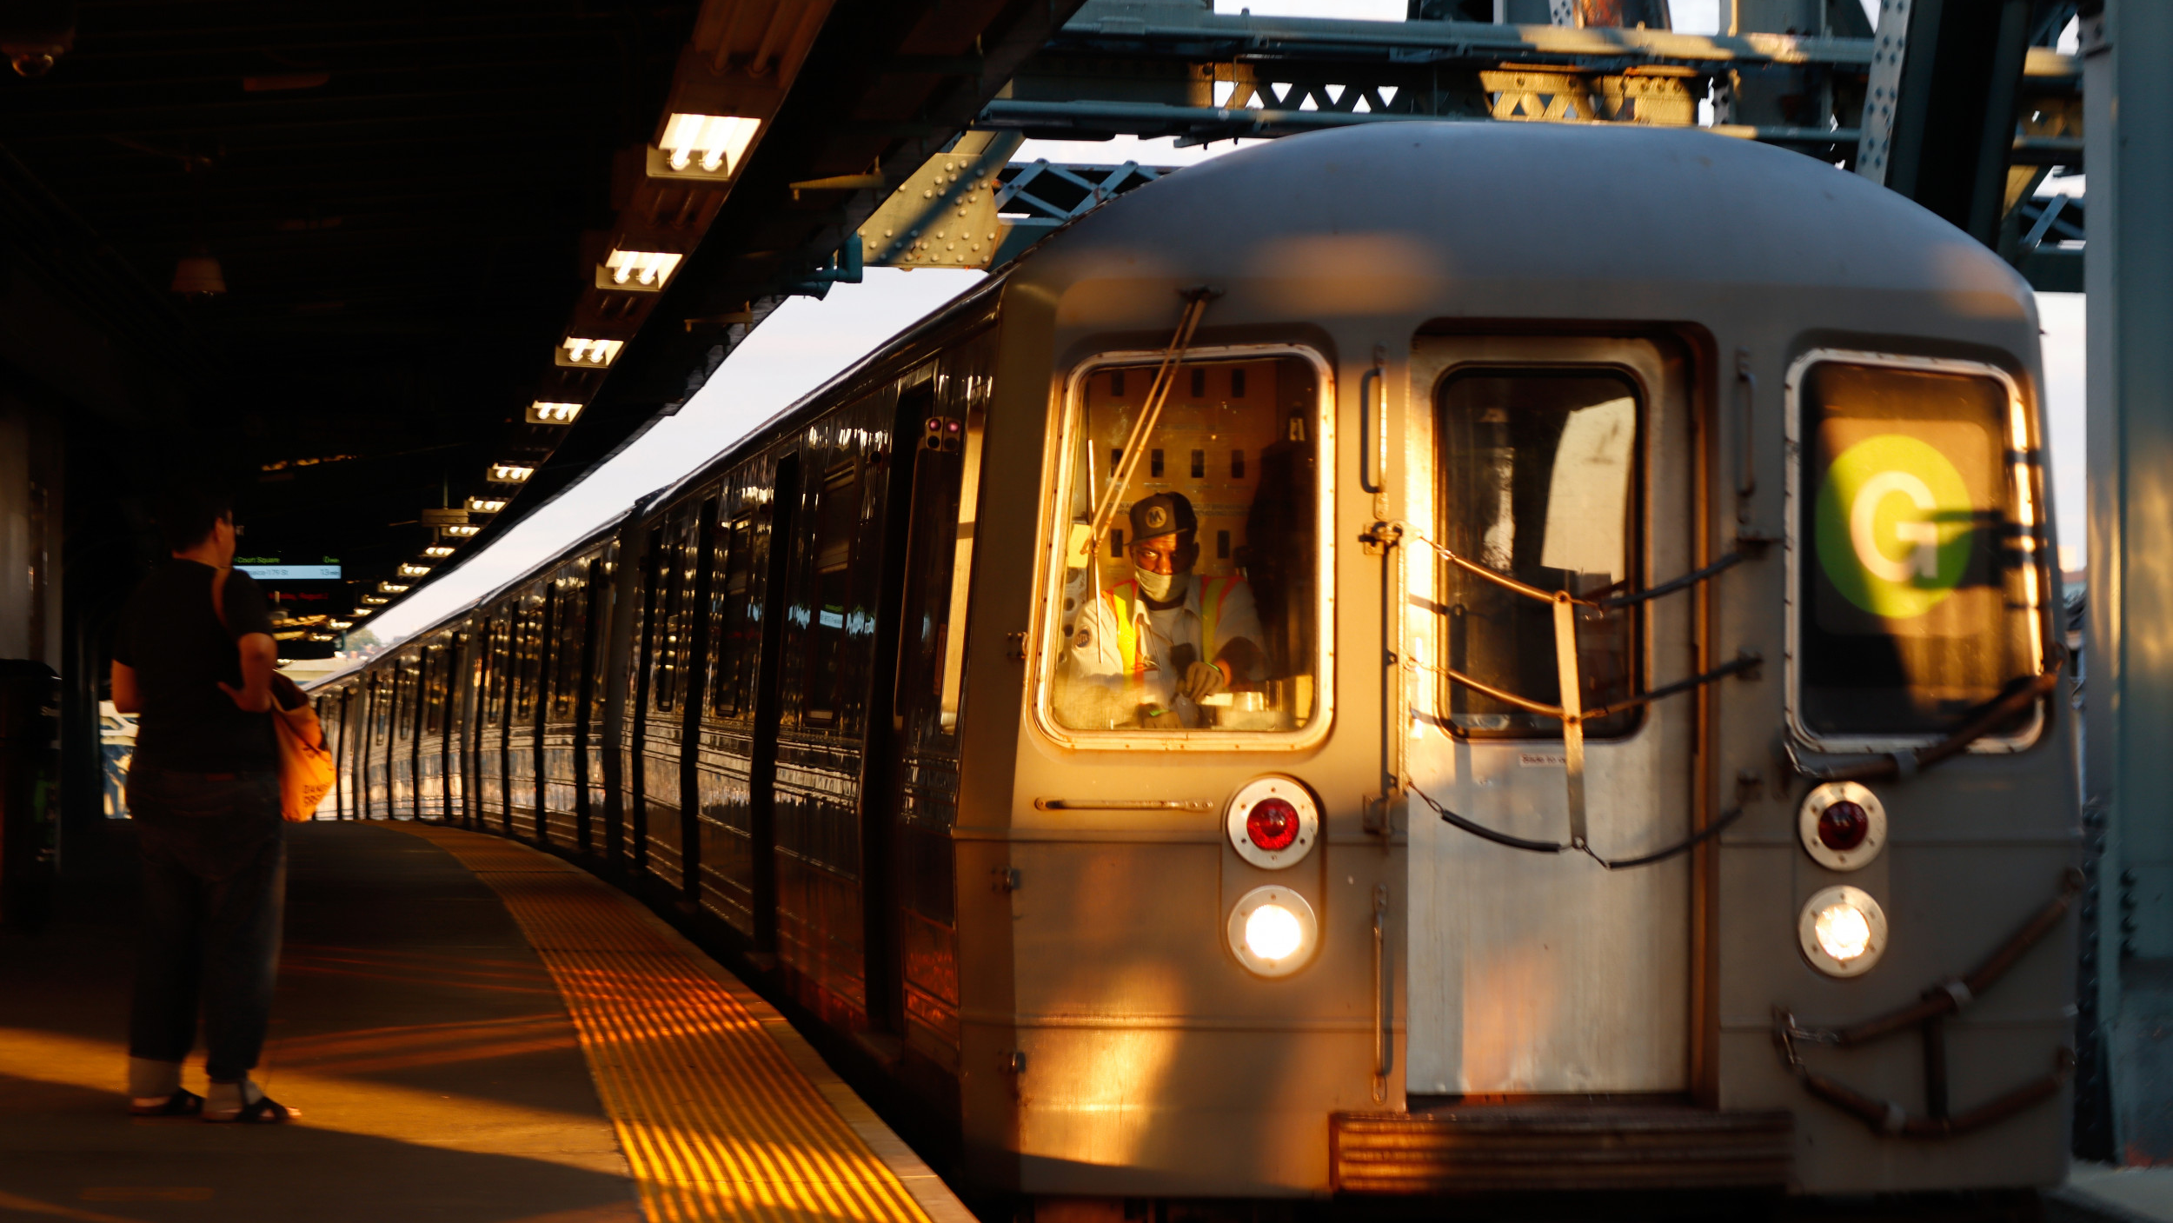
MTA Data Analysis of NY Subway
Senior connections- fundraising analyze
By Khulud Mansour Amer

Slide 2

Backstory
Senior connections -nonprofit -organization decides to launch a new location in NY city.
The organization is planning to have a fundraising in New York city which they hope to fill their event space with people passionate about increasing the participation of old people in society by improving quality of life for seniors and find usefulness in their daily tasks.
To support this fundraising Senior connections is doubling their effort by sending members to the busiest location “subway NY stations” to collect signatures via emails from travelers and send free tickets to them to attend the fundraising .
My duty is targeting the perfect(most crowded) location at NY subway stations(entries) to place our team by analyzing MTA database during June, July, August 2021, and collect signatures from the top 5 most crowded stations.
Facilitate the mobility of the team – save time , energy.

Slide 3

Tools
Python
Panda
NumPy
SQLalchemy
Matplotlib
Seaborn

Slide 4
Data sources
Perform a thorough Exploratory Data Analysis of the MTA turnstile data http://web.mta.info/developers/turnstile.html
Constrict three months from the above data : June, July, August 2021

Slide 5
Analytical Structuring
• Clean, explore, aggregate, and visualize the data for entries as appropriate to address the top 5 crowded stations
Plot the daily time series for the top 5 busiest stations at entries.
Make one list of counts for one week for one station. Monday's count, Tuesday's count, etc. so it's a list of 7 counts. Make the same list for another week, and another week, and so on.
plot of weekly commute numbers for every count list I create.

Slide 6
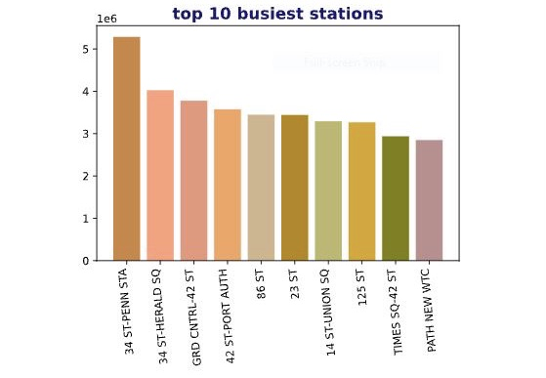
Visualization
Bar plot of the top 10 NY subway busiest stations at entries.

Slide 7
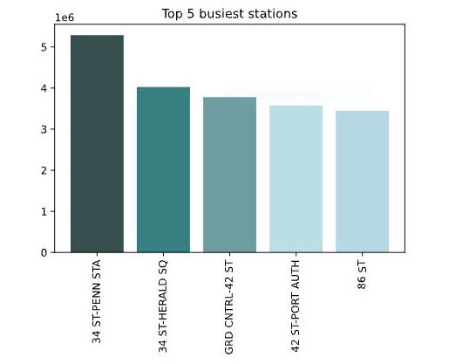
Visualization
Bar plot of the top 5 NY sub way busiest stations at entries.

Slide 8

Visualization of the top 3 busiest stations at entries

Slide 9
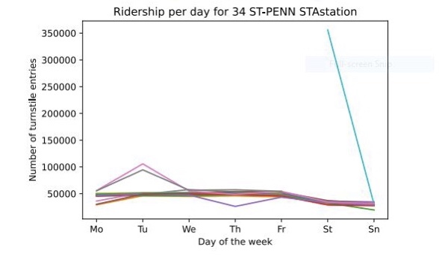

Slide 10
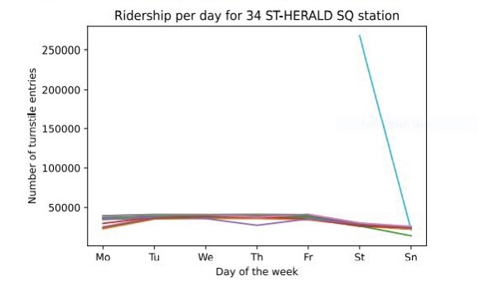

Slide 11
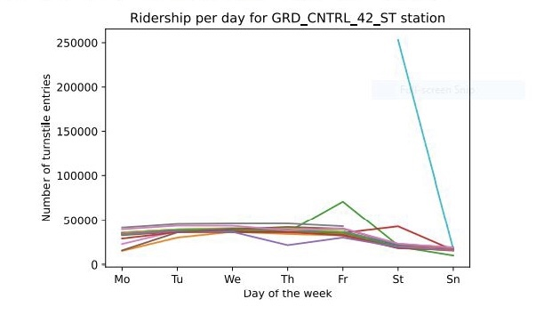

Slide 12
result
The plot of the top station (34 ST-PENN station) has shown increasing in the number of daily entries on Tuesdays over all 12 weeks, and decreasing on Thursdays, the other days we have plateau the number of daily entries were around 50000 and bellow.
The plot of the second top station 34 ST-HERALD SQ have shown also decreasing in the daily number entries on Thursdays, and not much acting in the remaining days of the weeks.
The plot of the third station GRD CNTRL-42 ST gives the highest numbers of daily entries on Fridays where it cross more than 50000. following by Saturdays we have less numbers of daily entries around 49890 but still consider a high number comparing with the remaining days count.
The reason we have this significant dropping in the number of daily entries on Thursdays is the flood that hit some entries of couple of stations and cause delay or canceling of more than 1156 station trips

Slide 13

QUESTIONS

